Slide 1
CIS CONTROL 13: DATA PROTECTION-II
DATA PROTECTION

Slide 2
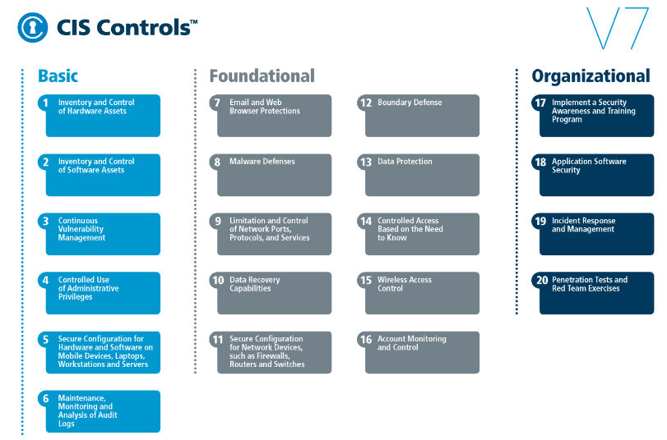
CIS CONTROL 13: DATA PROTECTION-II
https://www.cisecurity.org/controls/

Slide 3
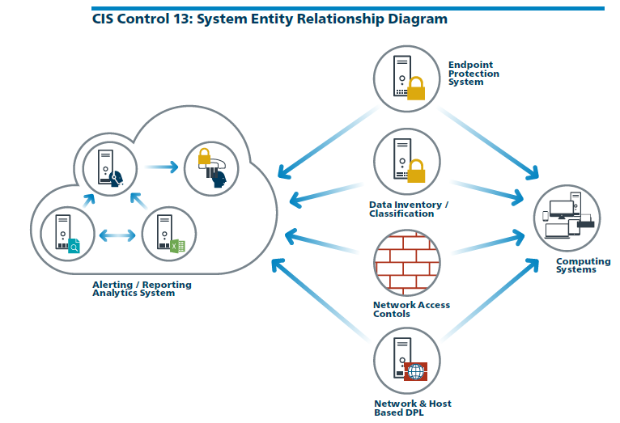
CIS CONTROL 13: DATA PROTECTION-II
https://www.cisecurity.org/controls/

Slide 4
CIS CONTROL 13: DATA PROTECTION-II
13.4: Only Allow Access to Authorized Cloud Storage or Email Providers
Only allow access to authorized cloud storage or email providers.

Slide 5
CIS CONTROL 13: DATA PROTECTION-II
13.5: Monitor and Detect Any Unauthorized Use of Encryption
Monitor all traffic leaving the organization and detect any unauthorized use of encryption.

Slide 6
CIS CONTROL 13: DATA PROTECTION-II
13.6: Encrypt the Hard Drive of All Mobile Devices.
Utilize approved whole disk encryption software to encrypt the hard drive of all mobile devices.
END

